Slide 1
Stable Marriage Problem
(Hospital-Intern Matching)
Basundhara Dey
Jaskaran Singh Bhatti

Slide 2
Layout
A Glimpse of History
Stable Marriage Problem
Formalization
Algorithm
Graph Model
Observations
Applications
Graph Theoretic Property
Hospital Intern Matching
Implementation
Difficulties While Implementing
References

Slide 3
A Glimpse of History
1962, David Gale and Lloyd Shapley .
- College admissions and the stability of marriage. American Mathematical Monthly, 69:9–15, 1962.
1970, McVitie and Wilson .
- The stable marriage problem. Communications of the ACM, 14(1971). pp. 486-492
1987, Rob Irving, P. Leather and D. Gusfield .
- An efficient algorithm for the "optimal" stable marriage. journal of the ACM, 34 (3) (Jul. 1987), pp. 532-543

Slide 4
Stable Marriage Problem
There are n boys and n girls.
Each has a preference list on the persons of the opposite sex.
Can we find a stable matching of men and women, such that there is no pair who both prefer each other in the matching?

Slide 5
Formalization
Set n boy S_{B} = {B₁ , B₂ , …., B_{n}}
Set n women S_{G} = {G₁ , G₂ , …., G_{n}}
Each man ranks the women in S_{G} in strict order of preference.
Each woman ranks the men in S_{B} in strict order of preference.
A matching S_{M} is a bijection between the men and women.
A (boy, girl) pair (B,G) blocks S_{M} if:
  b prefers g to his partner in S_{M}, and
  g prefers b to her partner in S_{M}.
In a S_{M} which has no blocking pair is Stable.

Slide 6
Gale-Shapley Algorithm
Initialize all b ∈ B and g ∈ G to free ;
while (some boy b is free & has a girl g to propose)
{
g := first ranked girl on b's list;
if g is free
(b, g) become engaged;
else
some pair (b', g) already exists
if g prefers b to b'
(b, g) become engaged;
b' becomes free;
else
(b', g) remain engaged;
}

Slide 7


A | 2 | 3 | 1
B | 1 | 3 | 2
C | 1 | 2 | 3
1 | A | B | C
2 | B | C | A
3 | C | B | A
A | 2 | 3 | 1
B | 1 | 3 | 2
C | 1 | 2 | 3
1 | A | B | C
2 | B | C | A
3 | C | B | A
A | 2 | 3 | 1
B | 1 | 3 | 2
C | 1 | 2 | 3
1 | A | B | C
2 | B | C | A
3 | C | B | A
B – 1 & A – 2 are engaged.

Slide 8
A | 2 | 3 | 1
B | 1 | 3 | 2
C | 1 | 2 | 3
1 | A | B | C
2 | B | C | A
3 | C | B | A
A | 2 | 3 | 1
B | 1 | 3 | 2
C | 1 | 2 | 3
1 | A | B | C
2 | B | C | A
3 | C | B | A
B – 1 & C – 2 are engaged.
A | 2 | 3 | 1
B | 1 | 3 | 2
C | 1 | 2 | 3
1 | A | B | C
2 | B | C | A
3 | C | B | A
A – 3 & B – 1 & C – 2 are engaged

Slide 9
Graph Model
A(231)
B(132)
C(123)
A | 2 | 3 | 1
B | 1 | 3 | 2
C | 1 | 2 | 3
1 | A | B | C
2 | B | C | A
3 | C | B | A
1(ABC)
2(BCA)
3(CBA)
A(231)
B(132)
C(123)
A | 2 | 3 | 1
B | 1 | 3 | 2
C | 1 | 2 | 3
1 | A | B | C
2 | B | C | A
3 | C | B | A
1(ABC)
2(BCA)
3(CBA)

Slide 10
A(231)
B(132)
C(123)
A | 2 | 3 | 1
B | 1 | 3 | 2
C | 1 | 2 | 3
1 | A | B | C
2 | B | C | A
3 | C | B | A
1(ABC)
2(BCA)
3(CBA)
A(231)
B(132)
C(123)
A | 2 | 3 | 1
B | 1 | 3 | 2
C | 1 | 2 | 3
1 | A | B | C
2 | B | C | A
3 | C | B | A
1(ABC)
2(BCA)
3(CBA)

Slide 11
A(231)
B(132)
C(123)
1(ABC)
2(BCA)
3(CBA)
A | 2 | 3 | 1
B | 1 | 3 | 2
C | 1 | 2 | 3
1 | A | B | C
2 | B | C | A
3 | C | B | A
A – 3 & B – 1 & C – 2 are engaged

Slide 12
Observations
This algorithm always terminates.
This algorithm finds stable marriages.
Male optimal Vs Female Optimal
Unequal sets of boys and girls.
Notes:
Known results

Slide 13
Applications
Graph Theoretic Property
- Independent Edge Set
- Bipartite matching problem
- Maximal Flow Min Cut Problem
Real Life Applications
- The roommate problem
- Hospital intern matching
- Intern assignment problem with couples
- College Admission

Slide 14
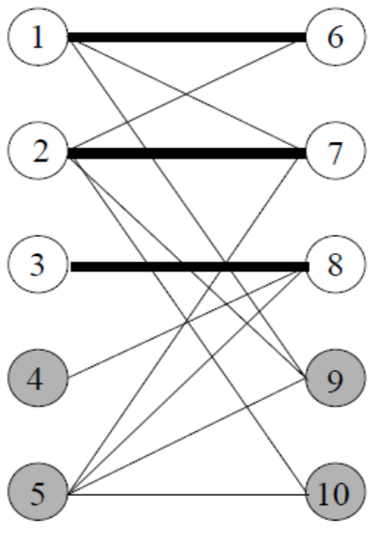
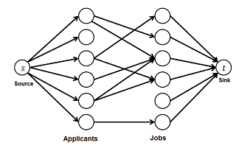
Graph Theoretic property
Independent edge set provides concept of singles in stable marriage.
Bipartite matching problem also relates to stable Marriage problem.

Slide 15
Hospital-Intern Matching
National Resident Matching Problem (NRMP)
Each applicant indicates preference ordering of positions
Each hospital submits its preference ranking of applicants
What if the Interns are married couple?
Notes:
Special case

Slide 16
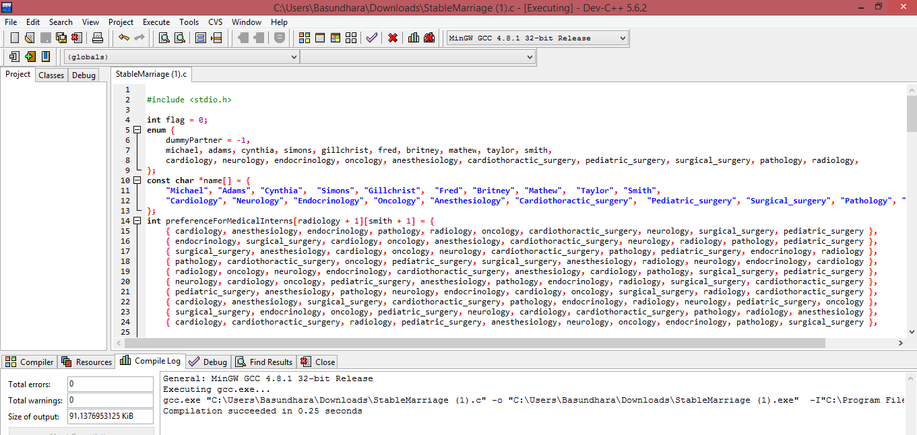
Implementation

Slide 17
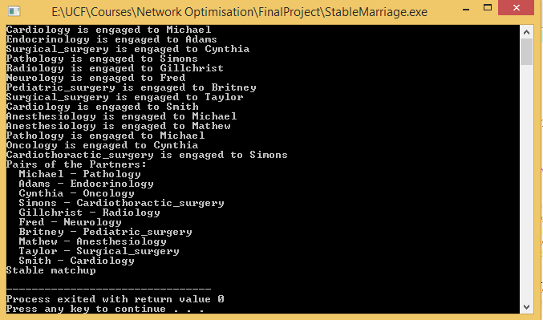

Slide 18
Difficulties While Implementing
The relationship of the problem with graph theory is not Discussed in papers.
Lack of proper visualization of dominating and un-dominated pairs.
Algorithm varies when real life applications comes with ties and affect the computation complexity too.

Slide 19
References
D.G.McVitie and L.B. Wilson. The stable marriage problem. Communications of the ACM, 14(1971). pp. 486-492
R.W.Irving, P. Leather, and D. Gusfield. An efficient algorithm for the "optimal" stable marriage. journal of the ACM, 34 (3) (Jul. 1987), pp. 532-543
D.G. Mcvitie and L.B. Wilson, “Stable Marriage assignment for unequal sets”, In Proc. of BIT, pp. 295 – 309, 1970.
I.P. Gent and P. Prosser, “An empirical study of the stable marriage problem with ties and incomplete lists”, Proceedings of the 15th European Conference on Artificial Intelligence, ECAI'2002, Lyon, France, July 2002.
M. Gelain, M.S. Pini, F. Rossi, K.B.Venable and T.Walsh, “Local Search for Stable Marriage Problems with Ties and Incomplete Lists”, In Proc. of PRICAI 2010, pp. 64-75, Springer-Verlag
M. Gelain, M.S. Pini, F. Rossi, K.B.Venable and T.Walsh, “Local Search for Stable Marriage Problems with Ties and Incomplete Lists”, In Proc. of PRICAI 2010, pp. 64-75, Springer-Verlag

Slide 20
Questions??
Thank you

